Slide 1
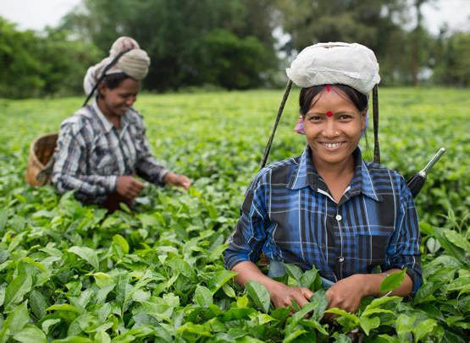


Fairtrade Introduction 2018
BY
FAIRTRADE INDIA
2018

Slide 2
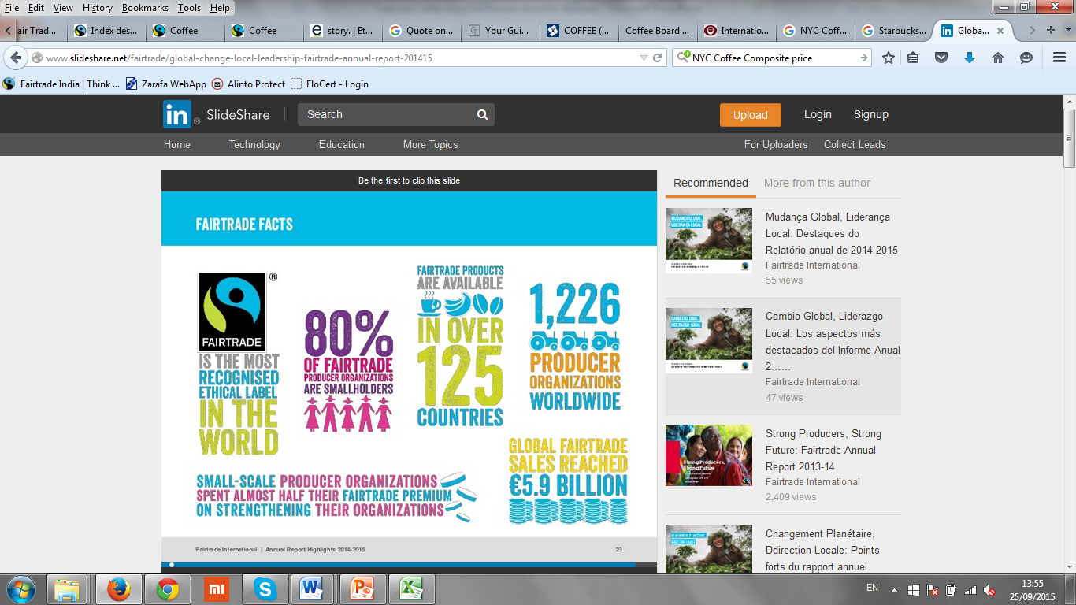
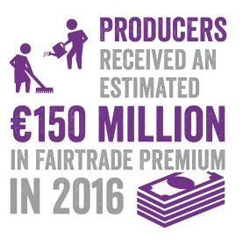
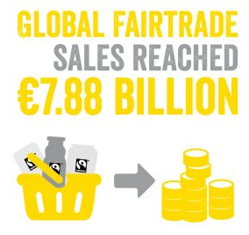




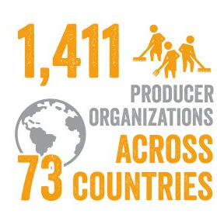
Global Fairtrade Facts : Fairtrade is an international movement for tackling poverty through trade not aid

Slide 3
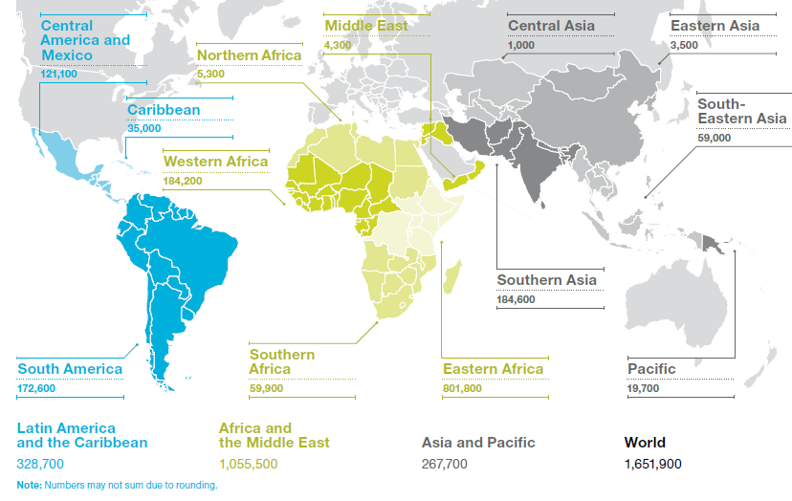
Strong global certified producer and supply chain network
High consumer awareness of the Fairtrade Mark globally

Slide 4
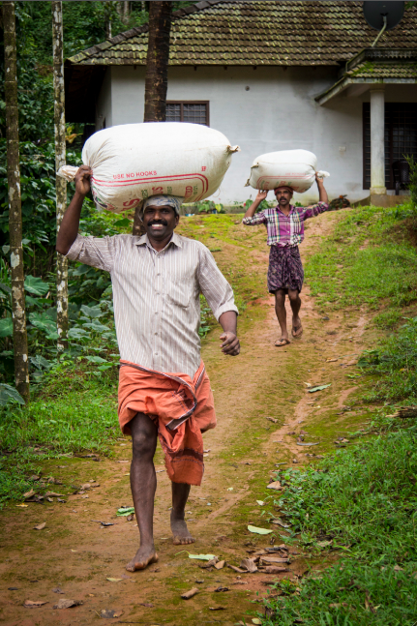
Components of Fairtrade Approach: A Social Contract for Sustainability
Works on unlocking the power of producer collectives. Helping marginal & small producers to get organised
Partner with businesses to enable domestic and international market access for these producers
Sustainable and equitable trading relationships with
    Minimum support price for producers
    Social investment in producer communities
Ensuring producer & business commitment to sustainable economic, environmental and social standards through independent audits by FLO-CERT- an ISO 65 Company
Producer capacity building & empowerment in areas including:
    Climate Change response
    Increasing women‘s participation in decisionmaking
    Commercial & technical training
Labelling on product & communication to consumers

Slide 5
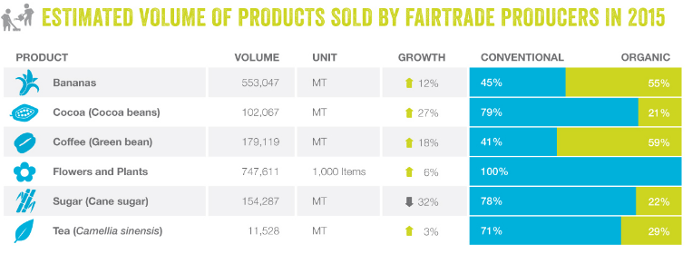
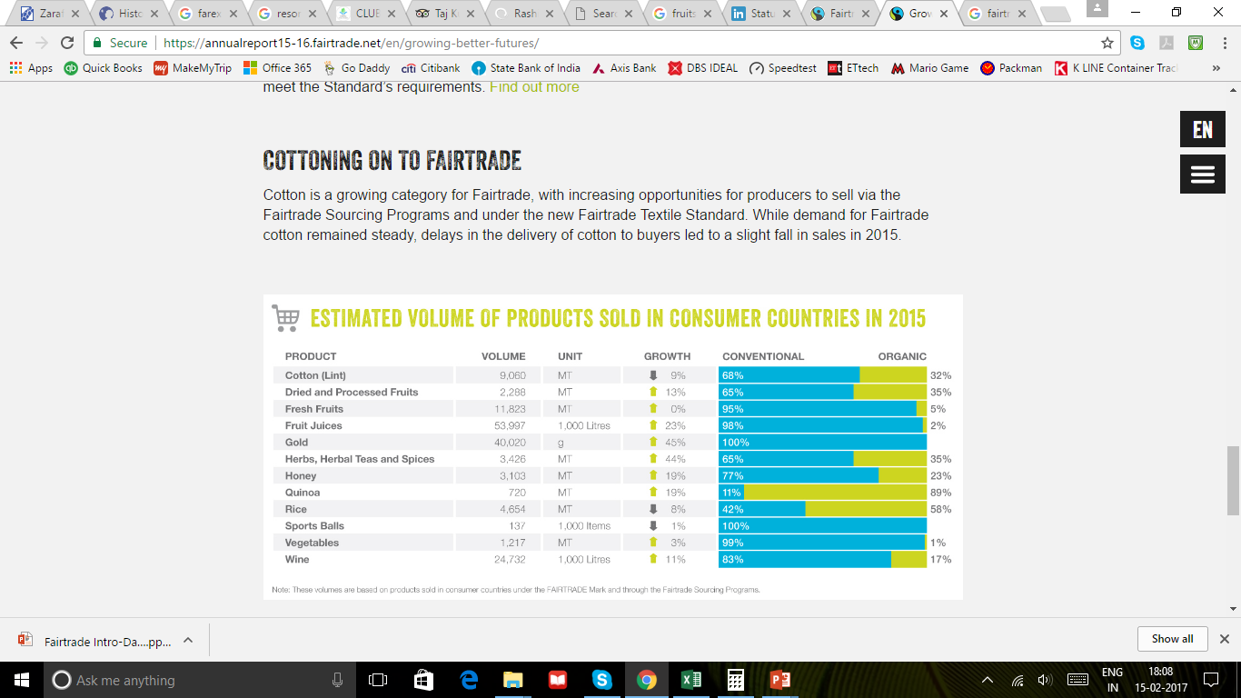
Fairtrade works across one of the widest range of agri-commodities

Slide 6
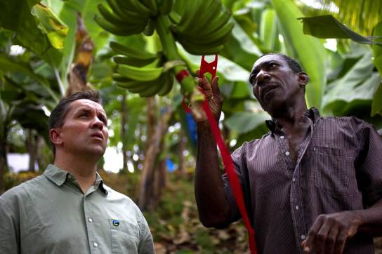












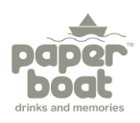
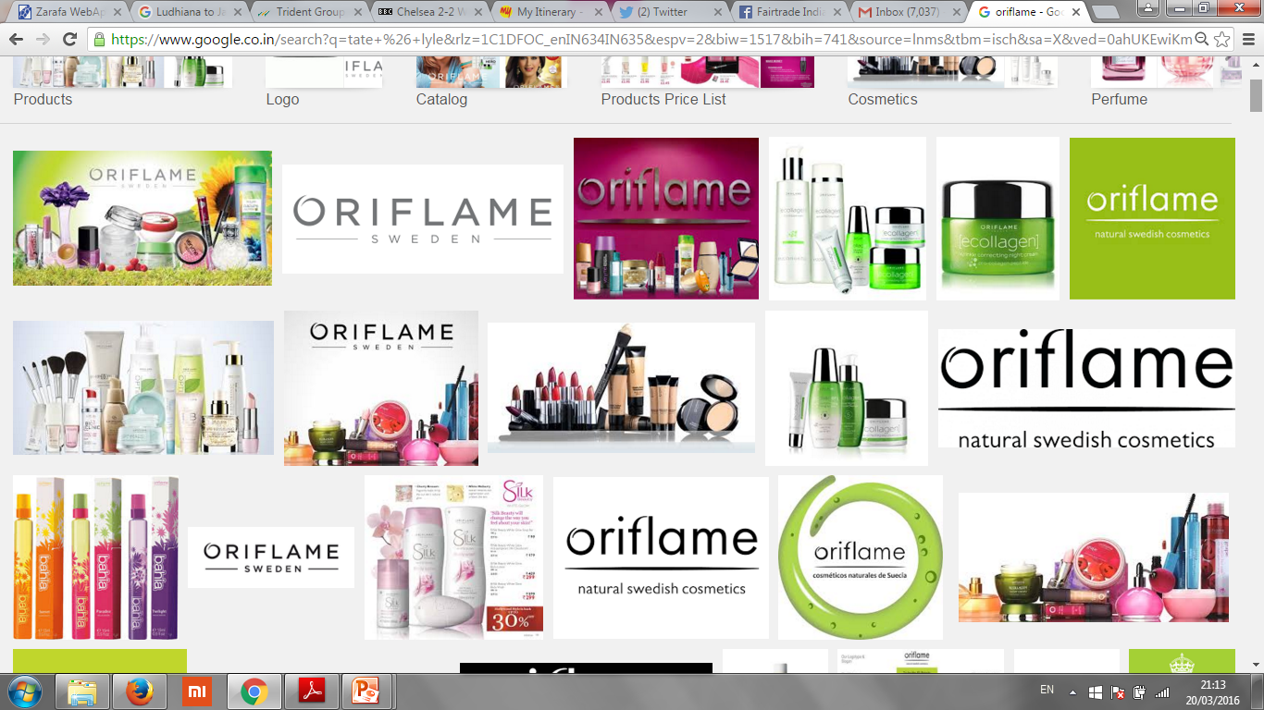
Fairtrade partners with businesses for creating sustainable supply chain
“I know that Fairtrade works. I have seen the positive impact on the banana growers in the Windward Islands since we decided at the end of 2006 to move Sainsbury’s bananas to 100% Fairtrade. But we are not doing this for altruistic reasons – we know that our customers support the objectives of Fairtrade in helping guarantee farmers in the developing world a fair and stable price.”
Justin King, Former CEO, Sainsbury’s
(UK’s 3rd largest supermarket)
6
Notes:
Driven by consumer demand for ethically traded products, 2,849 companies (Fairtrade licensees) have bought into the Fairtrade partnership, selling 27,000 products globally – including tea, coffee, bananas, cotton, cocoa, sugar, herbs & spices, shea butter, fresh fruit and vegetables and gold

Slide 7
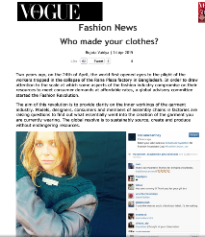
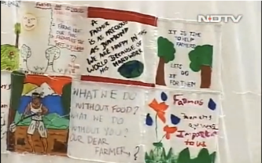
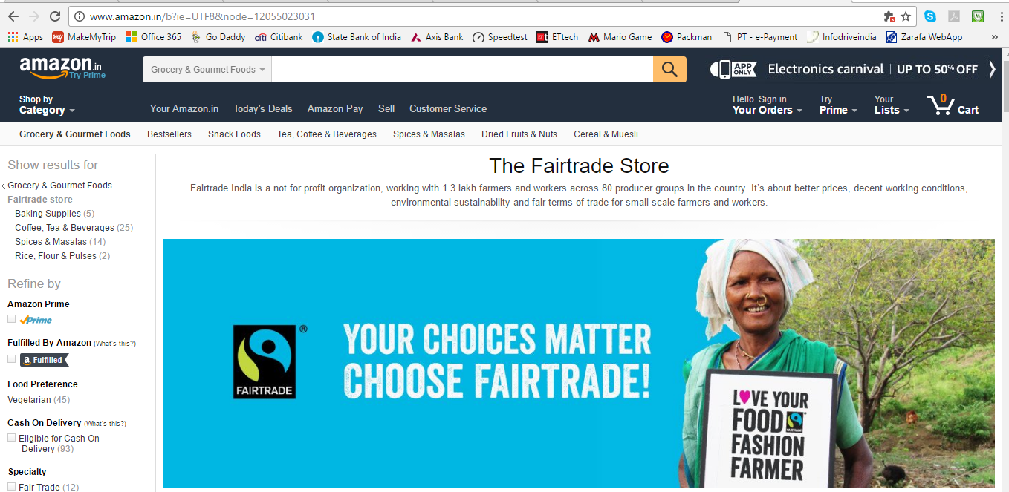
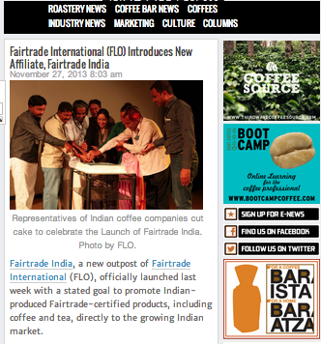
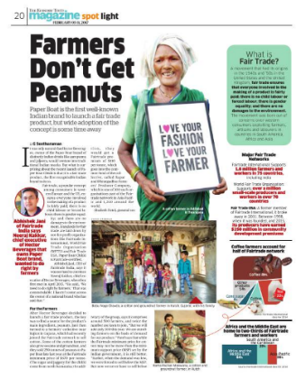
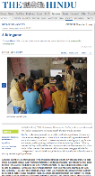
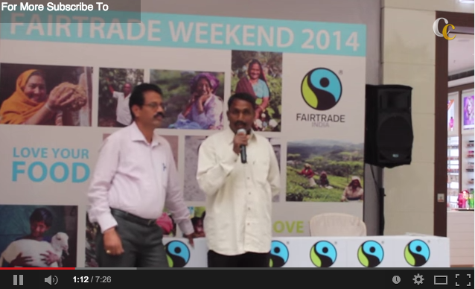


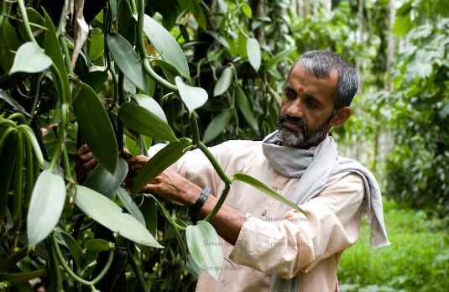
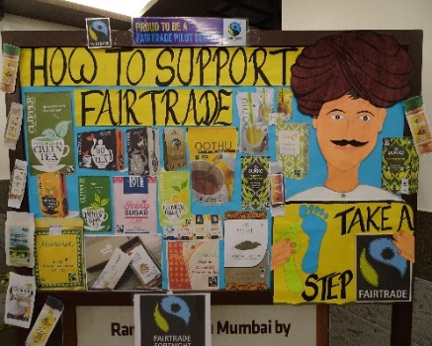
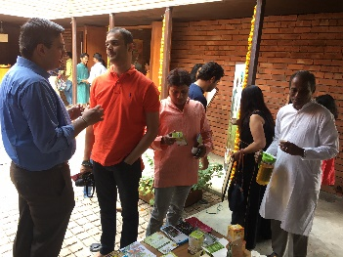

Media Engagement
Retail Activation
Fairtrade products available online on Amazon.in and Big Basket.com
Regular media coverage in TV, print and online media
Active across multiple social media platforms
Fairtrade products available across over 5000 point of sale in India
Direct Consumer Engagement
Producers
Fairtrade works closley with schools,
workplaces, universities, across
Consumer campaigns.
80 Fairtrade certified producer organizations in India
IN INDIA
1,47,600 farmers and workers on the Fairtrade system in India
India farmers received a total Fairtrade Premium of INR 20 CR in the year 2014

Slide 8
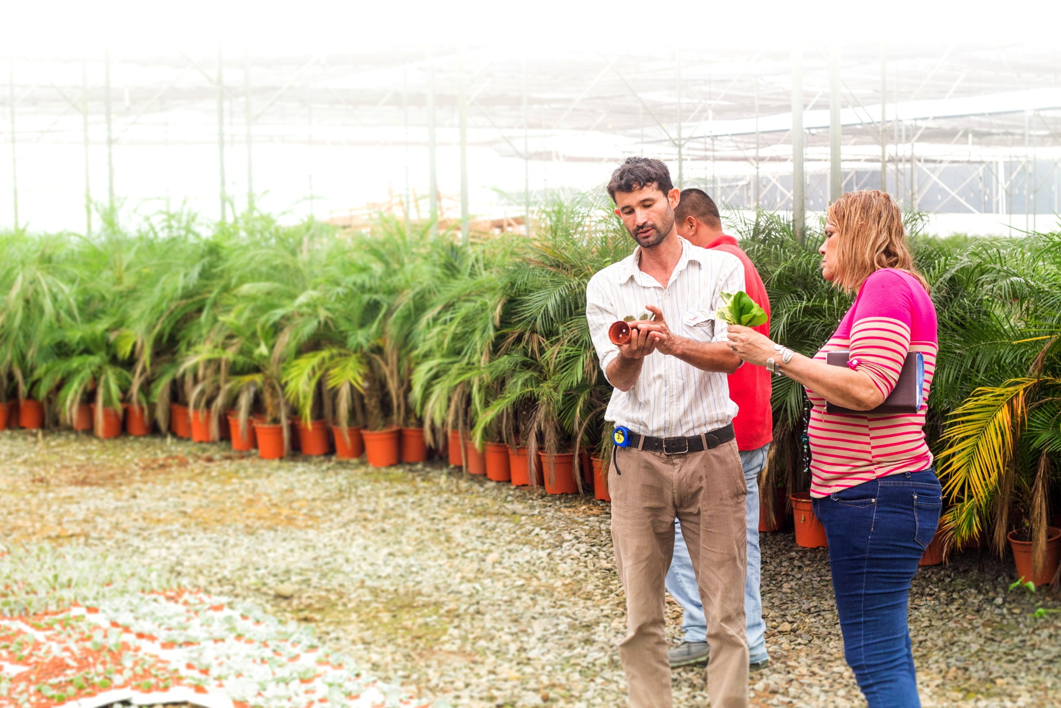

How could Fairtrade work for you?
Association with
MOST TRUSTED
third-party
certification
scheme
PROVEN TRACK RECORD on social, environmental and economic impact
GOOD CONSUMER RECOGNITION and trust brings value
and credibility to
your business
Simple way to help communicate that
YOUR COMPANY
IS DOING GOOD
Work with Fairtrade YOUR BUSINESS
CAN MAKE REAL IMPACT
A more credible
connect with
consumers
Better Risk
Management for
your agri-value chains
Deeper
sustainability
Impact

Slide 9
THANK YOU
Abhishek Jani
+91-9980282288
Abhishek.jani@fairtradeindia.org
Dhanraj Kidiyoor
+91-9986065567
Dhanraj.kidiyoor@fairtradeindia.org

